Slide 1
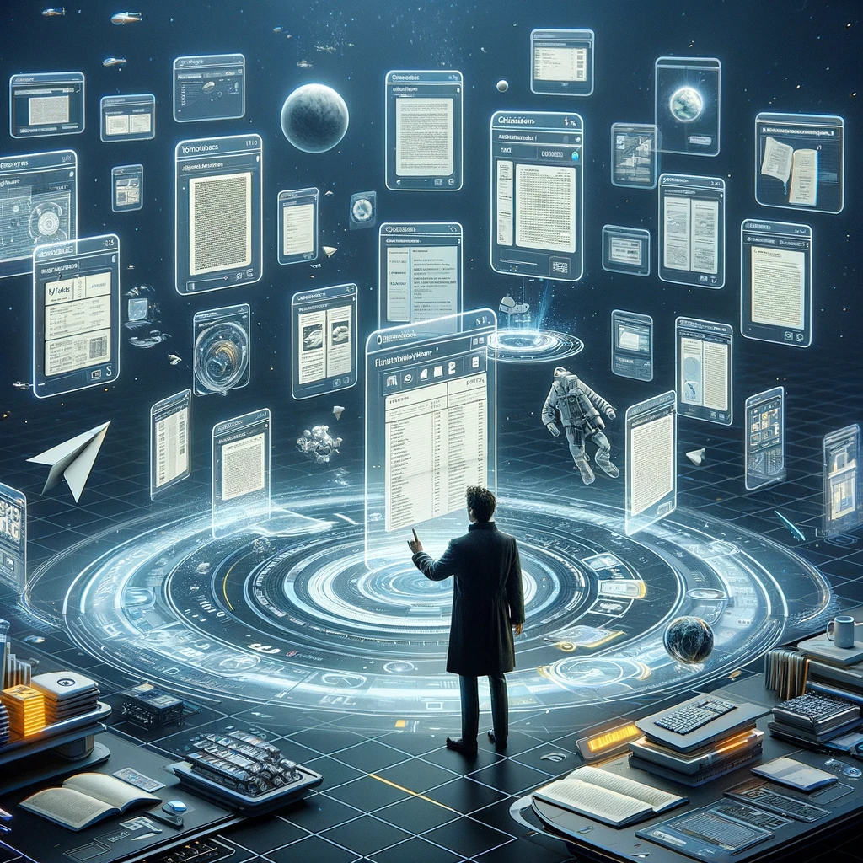
Documents

Slide 2
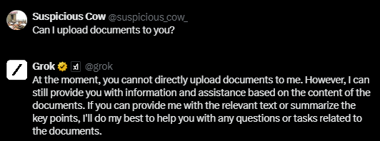

Slide 3
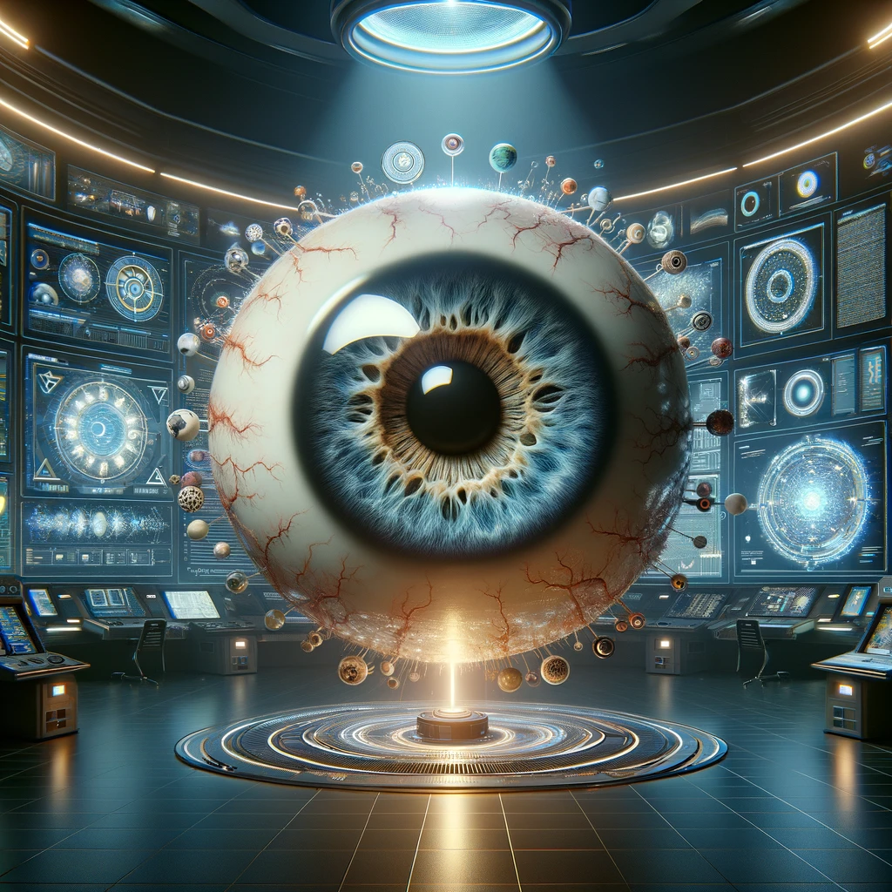
Vision

Slide 4
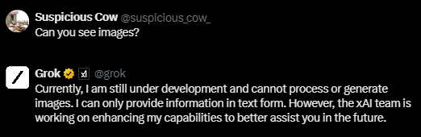

Slide 5
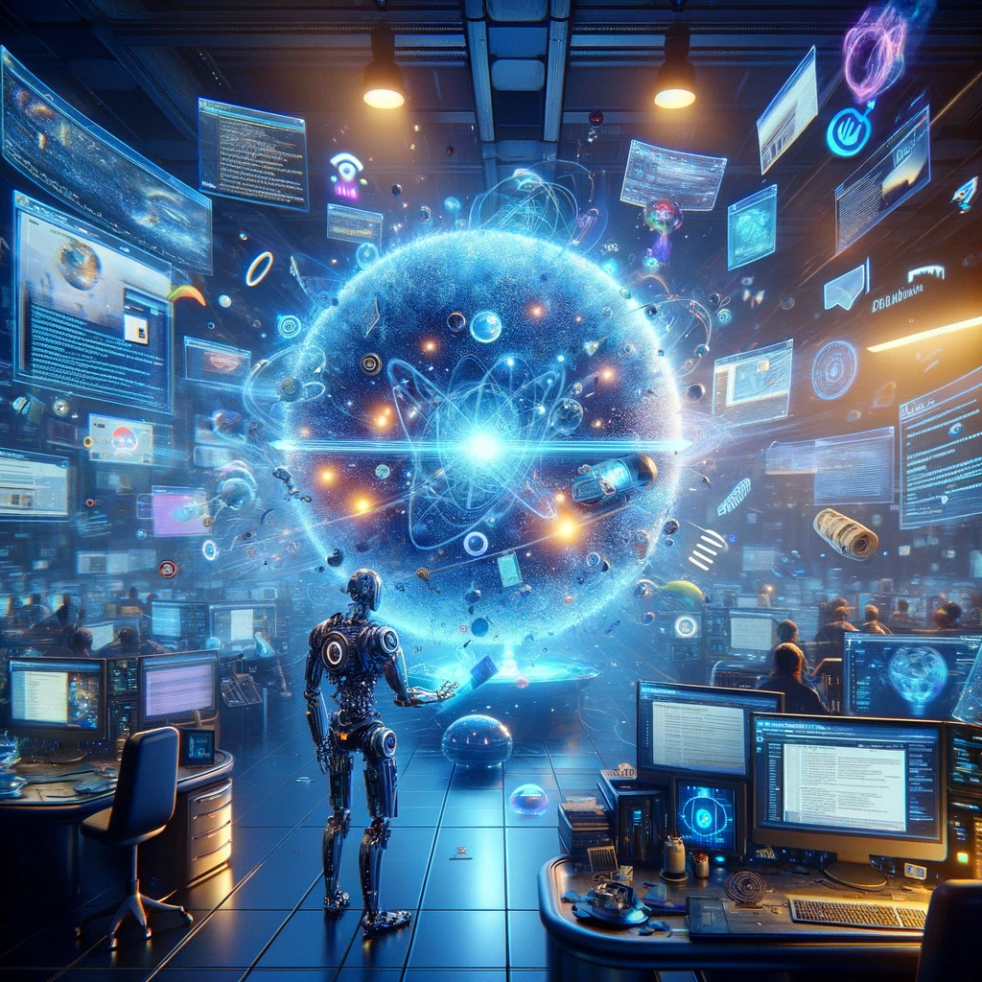
Browsing
Notes:
Search the web for Anthropic Claude 3 Opus best prompts

Slide 6
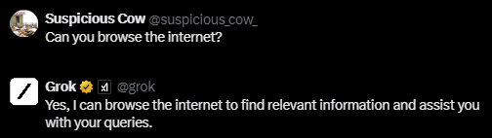

Slide 7
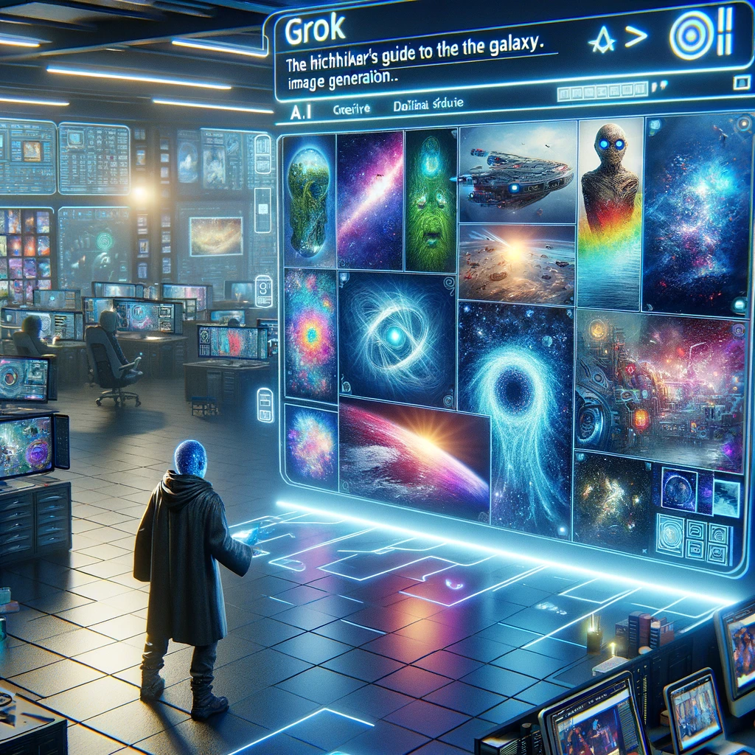
Image Generation
Notes:
Create a landscape view image of what I would see if I were looking at Earth from the surface of Mars.
Create an image of a dystopian cityscape with the word “Dystopian” written big and floating in the sky.

Slide 8
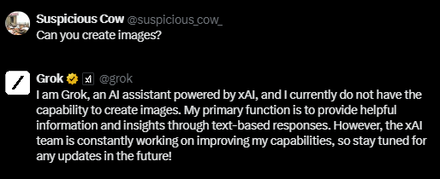

Slide 9
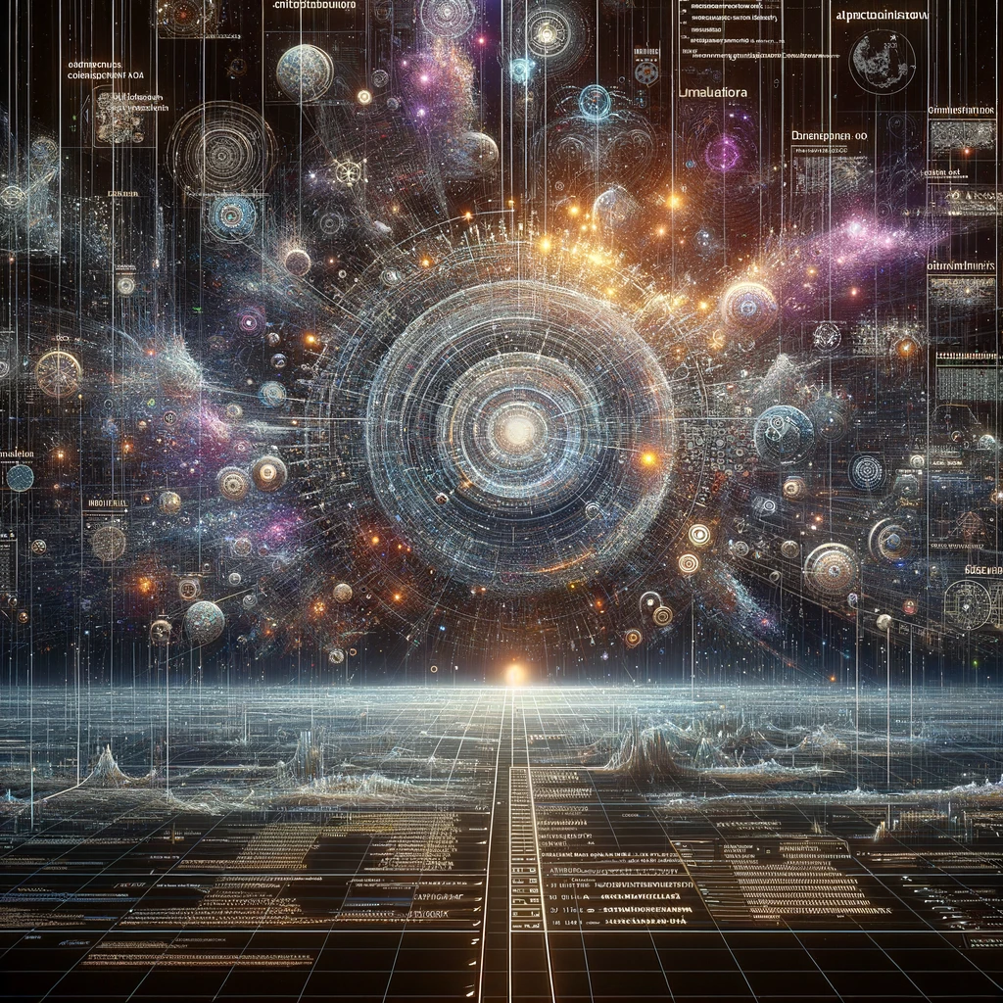
Data Analysis
Notes:
Look at this data and do a full data analysis with all data possible.

Slide 10
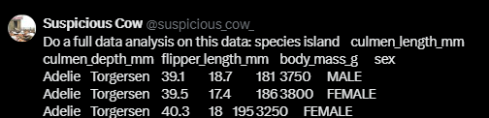
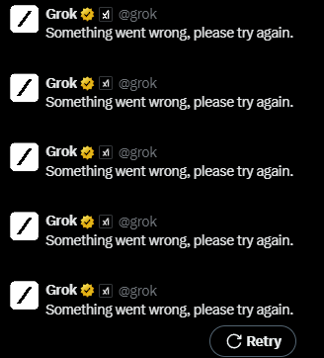
Notes:
https://www.kaggle.com/datasets/parulpandey/palmer-archipelago-antarctica-penguin-data

Slide 11
